Slide 1

Interacting with HTML and Web APIs

Slide 2
Web API
API (Application Programming Interface):
It is a software intermediary that allows two applications to talk to each other.
Web API:
When used in the context of web development, an API is typically defined as a set of specifications, such as Hypertext Transfer Protocol (HTTP) request messages, along with a definition of the structure of response messages.
Responses usually are in Extensible Markup Language (XML) or JavaScript Object Notation (JSON) format.

Slide 3
JSON
JSON: Java Script Object Notation.
JSON is a syntax for storing and exchanging data.
JSON is text, written with JavaScript object notation.
Exchanging Data:
When exchanging data between a browser and a server, the data can only be text.
JSON is text, and we can convert any object into JSON, and send JSON to the server.
We can also convert any JSON received from the server into objects.

Slide 4
JSON continued…
Sending Data:
If you have data stored in an object, you can convert the object into JSON, and send it to a server.
JSON Serialization:
converting objects to JSON format.
Eg:
var myObj = {name: "John", age: 31, city: "New York"}; var myJSON = JSON.stringify(myObj); window.location = "demo_json.php?x=" + myJSON;
Output:
John from New York is 31

Slide 5
JSON continued…
Receiving Data:
If you receive data in JSON format, you can convert it into an object.
JSON De-Serialization:
converting JSON to objects.
Eg:
var myJSON = '{"name":"John", "age":31, "city":"New York"}'; var myObj = JSON.parse(myJSON); document.getElementById("demo").innerHTML = myObj.name;
Output:
John

Slide 6
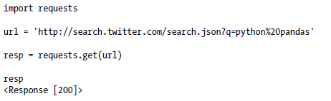
HTTP GET request
Using this we get the output in JSON format.
The Response object’s text attribute contains the content of the GET query.
Many web APIs will return a JSON string that must be loaded into a Python object

Slide 7
JSON Library in Python
import json
Method | Description
json.dumps() | Encoding objects to JSON objects
json.dump() | encoded string is stored file
json.loads() | Decode the JSON string
json.load() | Decode while JSON file read

Slide 8
Python to JSON (Encoding)
JSON string decoding is done with the help of inbuilt method dumps() & dump() of JSON library in Python.
Python | JSON
dict | Object
list | Array
unicode | String
number - int, long | number – int
float | number – real
True | True
False | False
None | Null

Slide 9
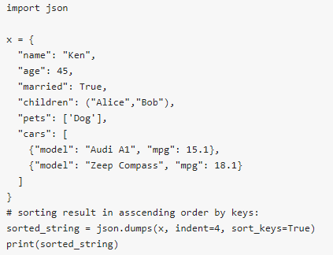
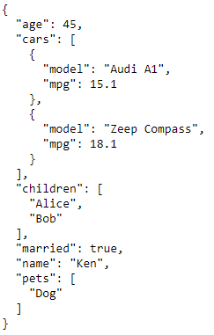
Python to JSON (Encoding)
json.dumps(python_object,indent,sort_keys):

Slide 10
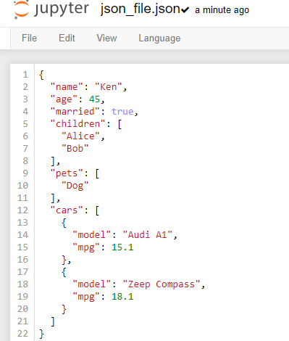

Python to JSON (Encoding)
json.dump(python_object,file_object,indent):
It creates a JSON file from Python objects.

Slide 11
JSON to Python (Decoding)
JSON string decoding is done with the help of inbuilt method loads() & load() of JSON library in Python.
JSON | Python
Object | dict
Array | list
String | unicode
number – int | number - int, long
number – real | float
True | True
False | False
Null | None

Slide 12
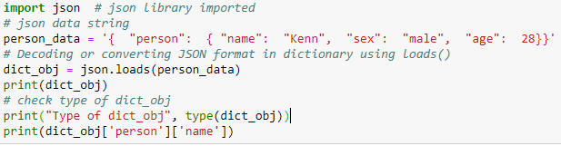

JSON to Python (Decoding)
json.loads():
convert json string object to python object.

Slide 13
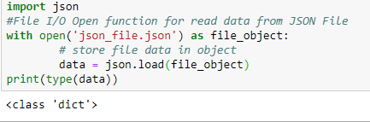
JSON to Python (Decoding)
json.load(file_object):
Decoding JSON file is File Input /Output (I/O) related operation. Takes a json file as a input and give python object as output.

Slide 14


